Slide 1
Washington, D.C.
Notes:
We are celebrating our 8th year of the campaign and our 7th Annual National Conversation on Board Diversity
We are tweeting from all the events today. If you are on Twitter, please join the conversation at #NCBD18.

Slide 2
11/14-15: 23 Events in 22 Cities
Austin, TX
Boston, MA (2)
Charlotte, NC
Chicago, IL
Columbus, OH
Dallas, TX
Detroit, MI
London, UK
Los Angeles, CA
Mexico City, MX
Miami/Fort Lauderdale, FL
Nashville, TN
New York, NY
Oklahoma City, OK
Phoenix, AZ
Pittsburgh, PA
Sacramento, CA
San Diego, CA
San Francisco, CA
Seattle, WA
Tampa Bay, FL
Washington, D.C.
Notes:
New cities this year: London, Mexico City, Nashville, Sacramento and Seattle.

Slide 3
Campaign Goals
Make gender diversity in the boardroom a priority
All companies to have boards with a minimum of 20% women directors by 2020
Collaborate with companies to add women directors
Reach millions of people to create a tipping point for change
Notes:
The campaign goals are:
Make gender diversity in the boardroom a priority.
All companies to have boards with a minimum of 20% women directors by 2020.
Collaborate with companies to add women directors.
Reach millions of people to create a tipping point for change.
The campaign works! When you add your voice and let companies know that you want change, they listen.

Slide 4
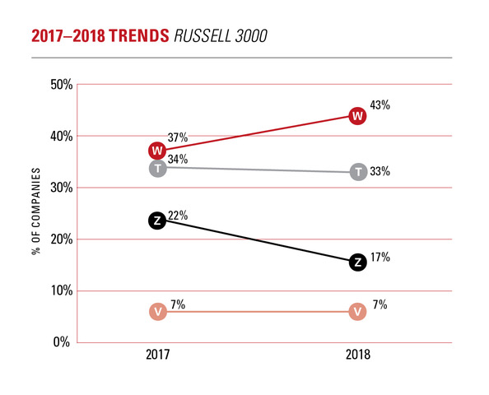
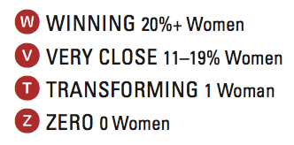
The 2020 Gender Diversity Index
2020 Women on Boards, Gender Diversity Index, November 2018
Notes:
We categorize companies as:
W: Winning companies with 20% or more women
V: Very Close but not 20%. 11 – 19% women
T: Transforming with 1 woman
Z: Zero. No Women
What’s remarkable about this chart is the rise in W companies and the decline in the other categories.
Still, 497 companies have zero women directors. 50% of Russell 3000 companies have one or no women on their boards.

Slide 5
Breakdown of Russell 3000 Percentage of Women on Boards 2018 - 2017
2015 FORTUNE COMPANIES
% WOMEN ON BOARDS
 | % WOMEN ON BOARDS
 | 2018 | 2017
Russell 3000* | 17.7% | 16.0%
Russell 100 | 25.3% | 23.9%
Russell 1000 | 21.3% | 19.6%
Russell 2001-3000 | 13.0% | 11.6%
*Based on 2835 companies in 2018 and 2871 companies in 2017.
2020 Women on Boards, Gender Diversity Index, November 2018
Notes:
Having made our initial goal of 20% women on boards of the Fortune 1000, we expanded our database to the Russell 3000. The percentage of women is 17.7% up from 16.0% in 2017. Note that smaller companies are significantly less diverse than larger ones. You can find the gender diversity of the boards of thousands of public companies on our Gender Diversity Directory on our website: 2020WOB.com

Slide 6
Board Turnover Trends: 2017 - 2018
2015 FORTUNE COMPANIES
% WOMEN ON BOARDS
 | BOARD SEATS
 | Women | Men
Net Change Seats | 469 | -382
Added Seats | 608 | 555
Lost Seats | -139 | -937
Based on 2629 companies in the Russell 3000 for years 2017 and 2018.
2020 Women on Boards, Gender Diversity Index, November 2018
63% of companies increased board size to add women directors.
Notes:
Looking at trends from 2017 and 2018, It is interesting to note that women gained 608 seats and lost 139 for a net gain of 469. Men, on the other hand gained 555 seats but lost 937 for a net loss of 382. Despite this great shift, 63% of the companies that added women, did so by increasing board size rather than waiting for a man to leave the board.

Slide 7
Top 25 IPOs: 2014 - 2018
2015 FORTUNE COMPANIES
% WOMEN ON BOARDS
Top 25 IPOs | % WOMEN ON BOARDS
 | At IPO | 2018*
2017 | 9.2% | 12.3%
2016 | 8.2% | 15.7%
2015 | 10.4% | 17.9%
2014 | 10.4% | 20.1%
*As of September 2018
2020 Women on Boards, Gender Diversity Index, November 2018
Notes:
This year 2020 Women on Boards incorporated their IPO research into the GDI report. At IPO the percentage of women averages below 10%. Eighty percent of companies go public with one or no women on their boards. While it appears to somewhat improve with time, we wish to encourage companies to add women before they go public.

Slide 8
Women on Boards in the D.C Area
GDI Fortune 1000 DC, MD, VA: # Companies | 2018 140 | 2017 148
% Women on Boards | 18.0% | 16.1%
# W Companies (20%+) | 67 | 57
Based on the Russell 3000 Index for years 2018 and 2017.
2020 Women on Boards, Gender Diversity Index, November 2018
The D.C. area companies have 237 women directors
The D.C. area (DC, MD, VA) needs 99 – 108 women for all
companies to reach 20%
Notes:
The mid-Atlantic states of Maryland, Virginia and the District of Columbia have 140 companies in the 2020 Gender Diversity Index and 67 of them are at 20% or greater. The percentage of women directors is 18.0%, which is above the national average and a significant improvement since last year. The breakdown is 18.3% for Maryland, 18.1% for Virginia and 15.6% for D.C. In the mid-Atlantic companies, there are currently 237 women directors. For the remaining 73 companies that are not yet at 20%, MD, VA and DC need 99 more women if women replace men; 108 more women if seats are added for all companies to be at 20% or greater.

Slide 9
The 2018 Strategic Question:
How can we collaborate with companies to
include women on boards?
Thank you for joining today’s event.
Become a supporter: www.2020WOB.com
Follow us on Social Media
Notes:
In cities all across the country, thousands of event attendees will be discussing this question. Follow the conversation on social media and watch the conversation move across the country!
Download our latest report: the 2018 Gender Diversity Index on our website: www.2020WOB.com

